Slide 1


Start Smart 1.0
1st Grade
Lesson 11

Slide 2

ELD Objective
ELD Objective: Students will be able to engage in a Constructive Conversation using the Constructive Conversation Skill of NEGOTIATE, by taking turns, sharing ideas and making ideas clearer with a partner based on a visual text.

Slide 3
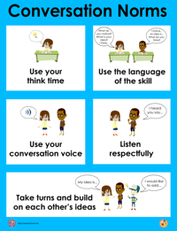
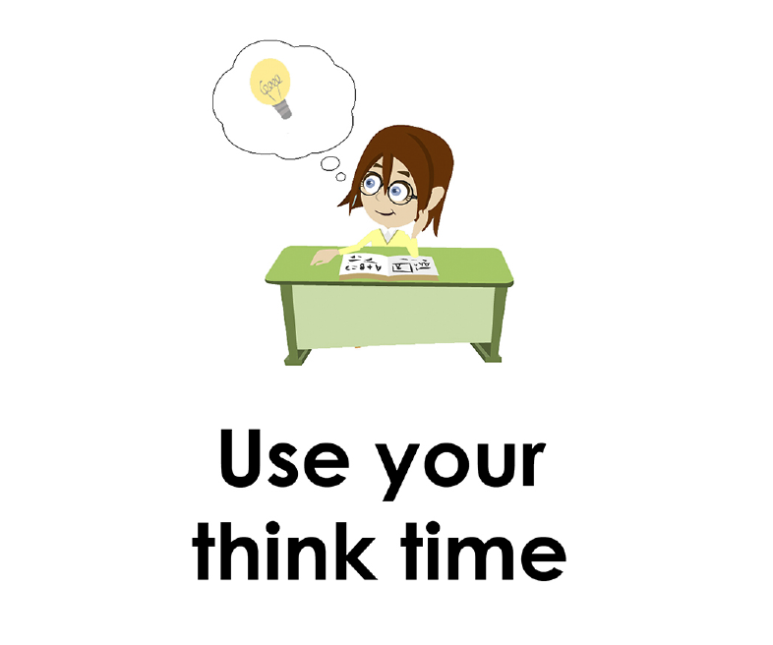
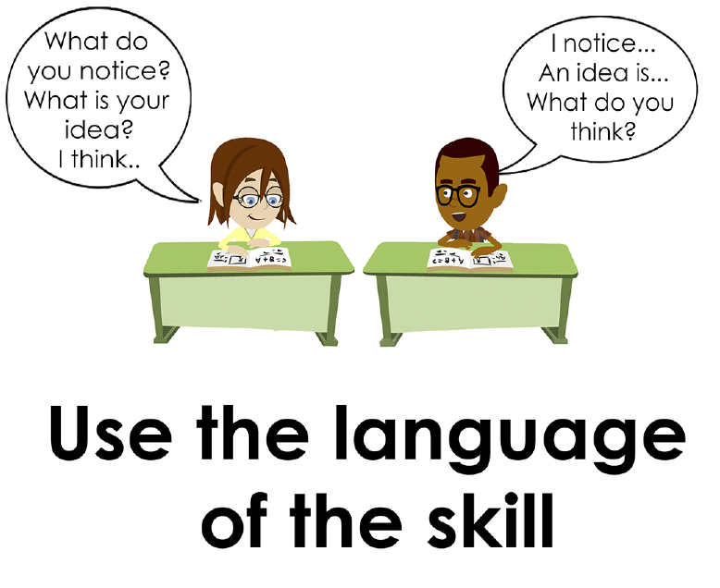
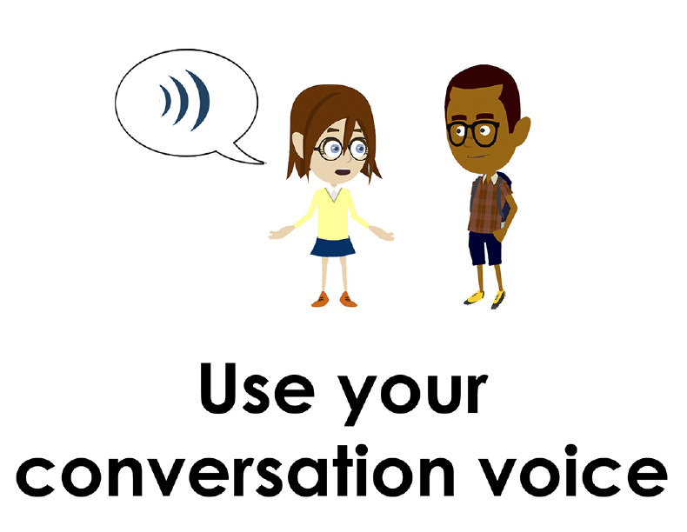
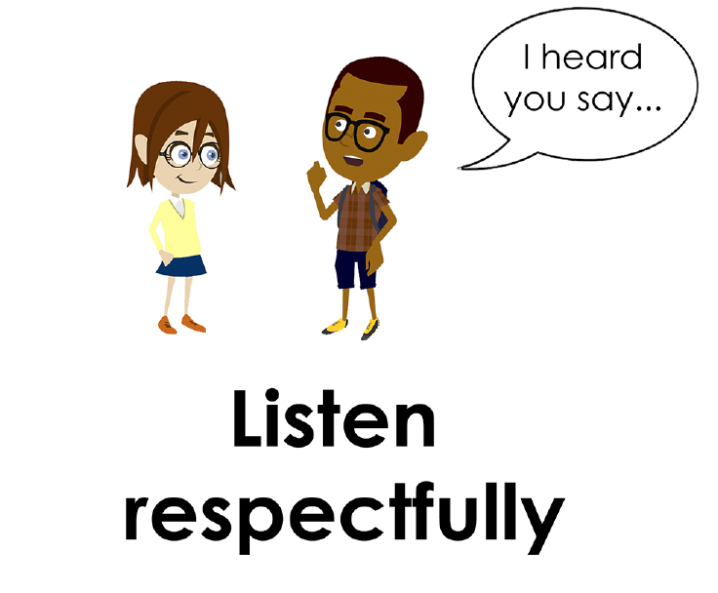
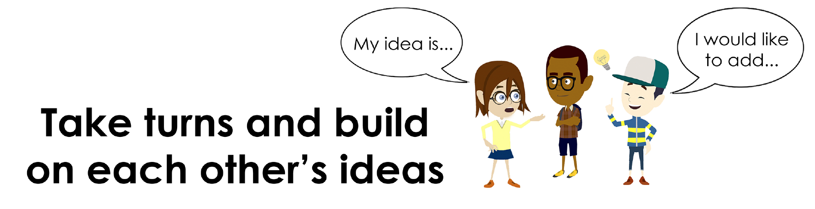
Conversation Norms Poster
  Use your think time
  Use the language of the skill
  Use your conversation voice
  Listen respectfully
  Take turns and build on each other’s ideas

Slide 4
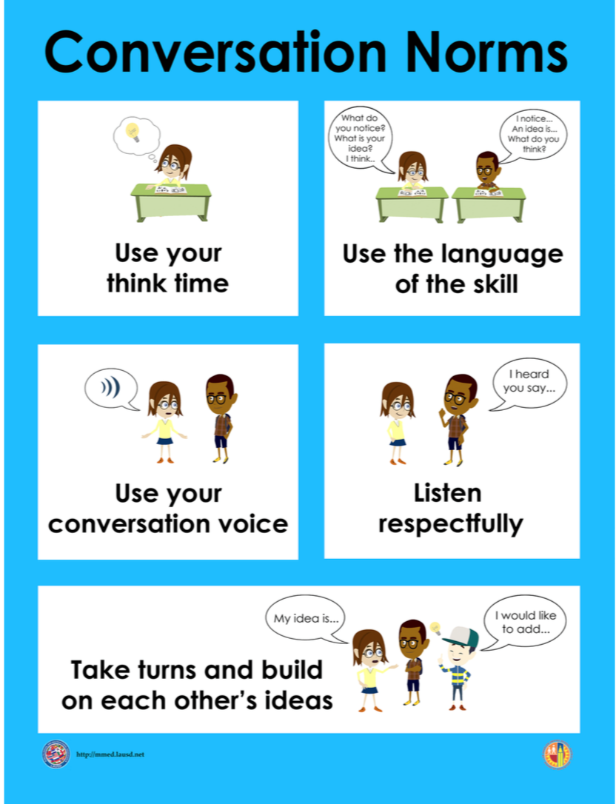
Notes:
The focus today is:
Use your think time
Use the language of the skill

Slide 5
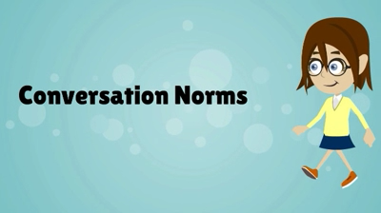
Conversation Norms
Notes:
Show Constructive Conversation Norms Video as a review of all norms

Slide 6
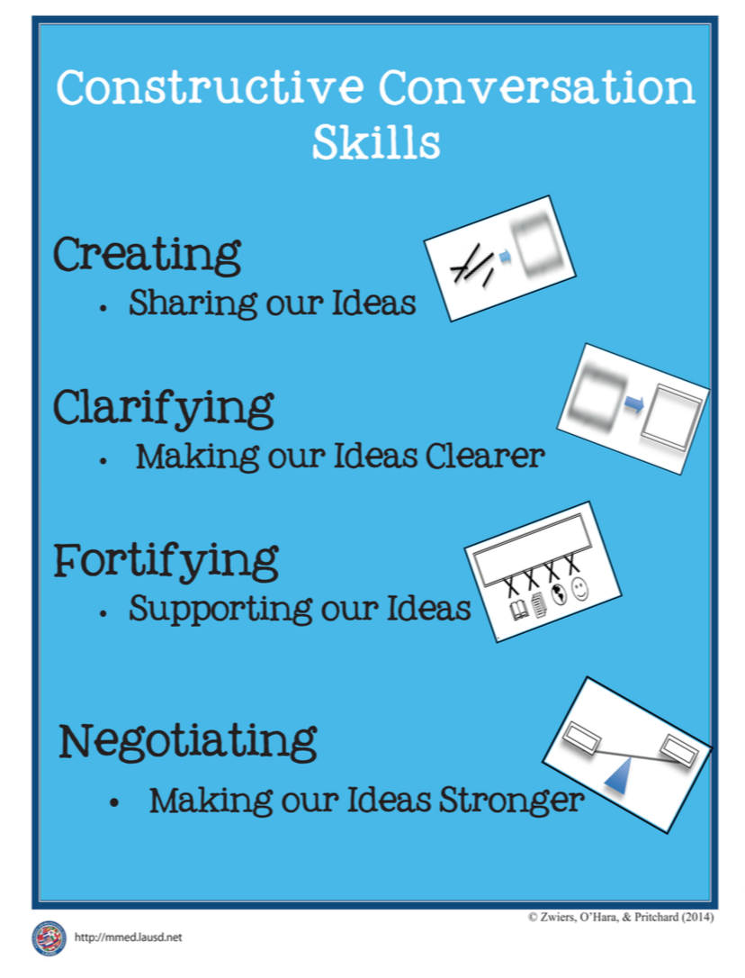
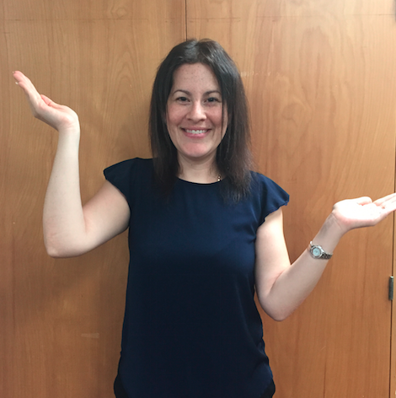
Hand Gesture and Phrase- NEGOTIATE
Making our Ideas Stronger
Notes:
Model NEGOTIATE and have participants repeat with you:
Place hand, palm down in front of you as if putting an idea on the table. Use four fingertips of the other hand to support the palm.

Slide 8
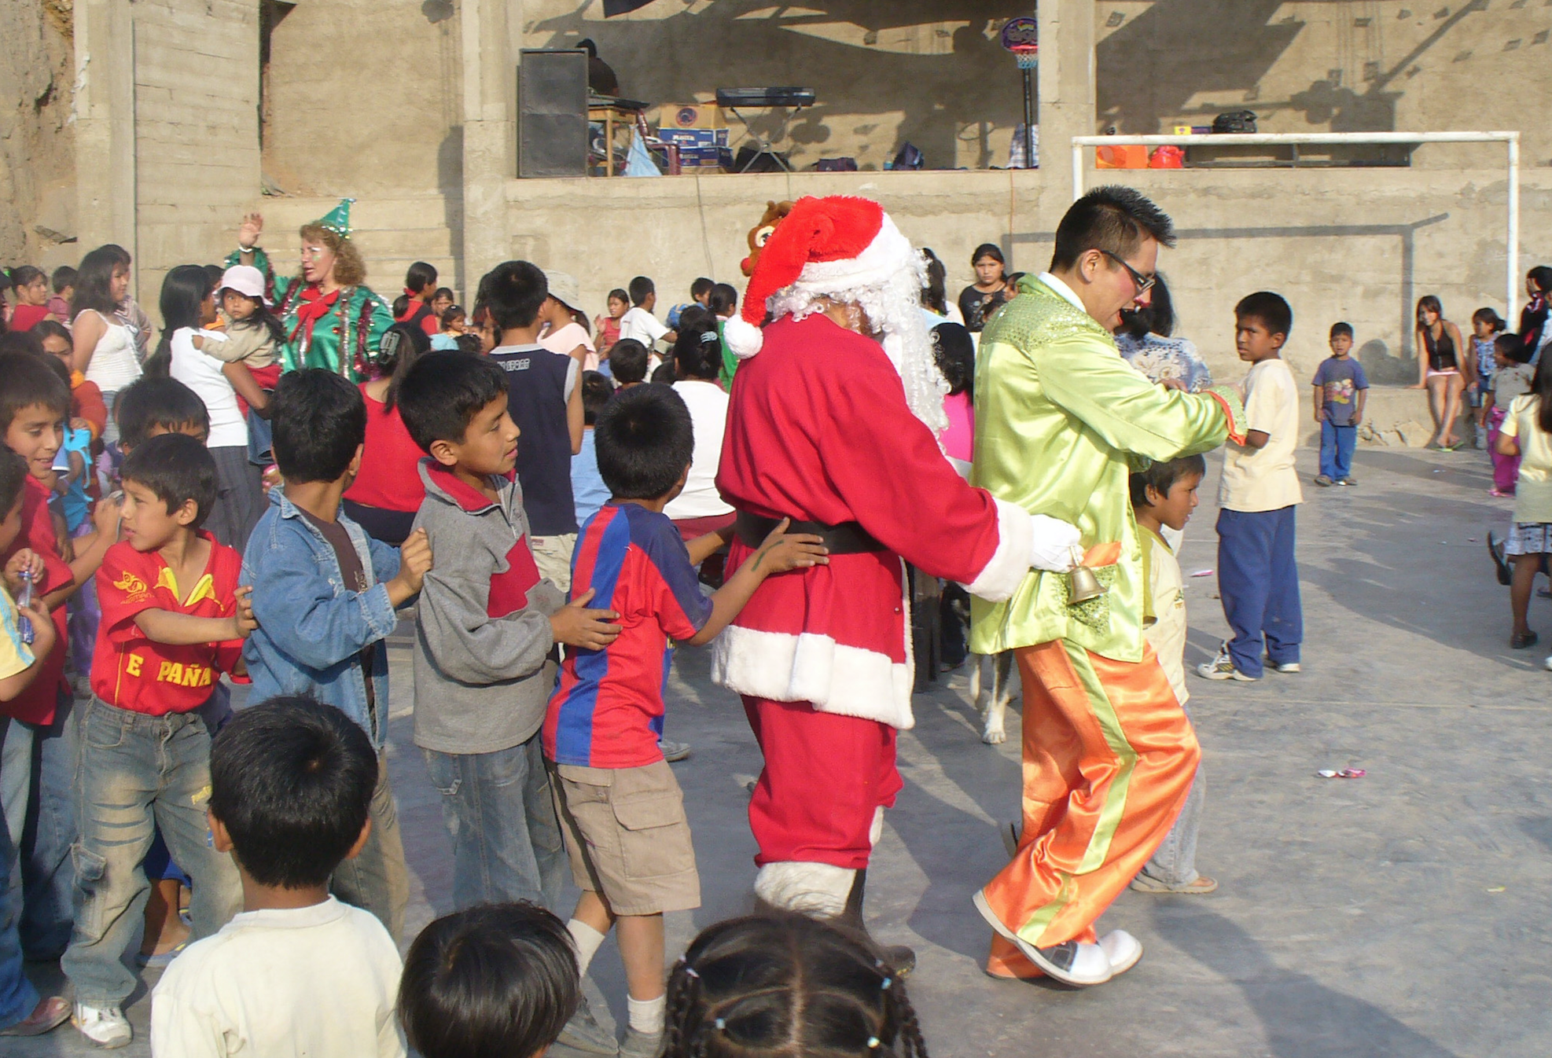
Prompt:
What is an important idea from this text? Start by stating your claim. Support your claim and come to a consensus.
TEACHER VISUAL TEXT

Slide 9


Listen to the Model Constructive Conversation
  Use your think time to study the visual text.
Listen actively to what two partners say to each other.
Notes:
Provide a copy of the Model Script to the volunteer and allow time beforehand for student to review the script. Suggestions for reading the script:
● Show a video of students having the model conversation (optional)
● Student volunteer and teacher read model script
STUDENT LISTEN ACTIVELY

Slide 10
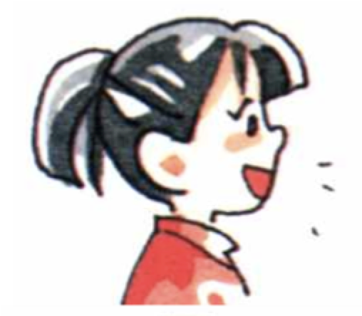
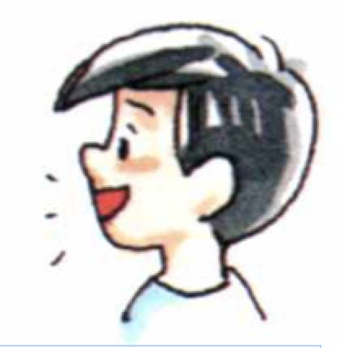
Visual Text Model
What is an important idea from this text? Start by stating your claim. Support your claim and come to a consensus.
Partner A: An important idea from the visual text is that dancing together with friends can be fun. What is your idea?
Partner A: I think the children are dancing to music. The two mean are leading a conga dance and are taking the children around the playground. The children are following the two men. What supports your idea?
Partner A: I think the two men are leading a conga line and showing the children a way to have fun. What evidence supports your idea?
Partner A: I think dancing can be a fun way to celebrate for children and adults. Can we come to a consensus?
Partner B: An important idea from the visual text is that dancing can be a way to celebrate. How can you support your claim with evidence?
Partner B: I think the two men are getting everyone to dance so they can celebrate Christmas. One man is wearing a Santa suit and a bell. The other man is wearing a bright yellow suit and is in front of the line leading the group. What evidence supports your idea?
Partner B: I think the two men are leading the children in a dance so they can celebrate Christmas. How can we come to a consensus?
Partner B: I think the important idea we agree on is that dancing is a fun way for adults and children to celebrate Christmas.

Slide 12
Listen to the Non-Model Constructive Conversation
  Use your think time to study the visual text.
Listen actively to what two partners say to each other.
Notes:
Provide a copy of the Non-­‐‑Model Script to the volunteer and allow time beforehand for student to review the script. Suggestions for reading the script:
● Show a video of students having the model conversation (optional)
● Student volunteer and teacher read model script
STUDENT LISTEN ACTIVELY

Slide 13
Visual Text Non- Model
What is an important idea from this text? Start by stating your claim. Support your claim and come to a consensus.
Partner A: There are people dancing.
Partner A: I notice it is Christmas.
Partner A: I think all mom are visiting the school.
Partner A: I notice there are lot of children in the playground.
Partner B: The kids are in line. How can you support your idea with evidence?
Partner B: I notice the Santa Claus.
Partner B: The children are in the playground.
Partner B: There is a person talking to the parents.

Slide 14

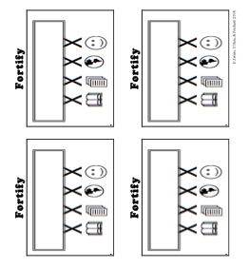
Constructive Conversation Game
PROMPT:
What is an important idea from this text? Start by stating your claim. Support your claim and come to a consensus.
Rules of the game:
Each of you needs 1 CREATE, 1 CLARIFY, 1 FORTIFY, and 2 NEGOTIATE cards
Each of you will play one card as you share an idea. You will continue taking turns until all cards are placed in the middle.
If you’re done early repeat the process for an additional round.
Remember to use the Constructive Conversation Norms and Skills as you play the game.
Notes:
You are now going to have the opportunity to practice the Constructive Conversation Skill NEGOTIATE while playing a game.
Explain the rules of the Constructive Conversation Game to students.

Slide 15

Prompt: What is an important idea from this text? Start by stating your claim. Support your claim and come to a consensus.
TEACHER COLLECTS LANGUAGE SAMPLE SPF 1.0
STUDENT VISUAL TEXT
Notes:
Display the Student Visual Text
Direct students to use their Think Time
As the students play the game, the teacher listens and selects two students who will replay the game in front of the class to serve as models.
This is an opportunity to capture a language sample.

Slide 16


CONSTRUCTIVE CONVERSATION
FISHBOWL MODEL
PROMPT: What is an important idea from this text? Start by stating your claim. Support your claim and come to a consensus.
Listen actively to what two partners say to each other.
FORMATIVE ASSESSMENT– TEACHER COLLECTS LANGUAGE SAMPLE SPF 1.0
Notes:
The two selected students will replay the game in front of the class and serve as models.
Student Progress Form (SPF)-­‐‑ Constructive Conversation Language Sample The teacher will collect a language sample from the two students on the Student Progress Form (SPF)-­‐‑ Constructive Conversation Language Sample to be used in Lesson 2. The language sample must be at least four turns in length. (Each turn includes both Partner A and B sharing

Slide 17
WRAP-UP
How did we meet today’s objective of using the Constructive Conversation Skill of NEGOTIATE?
How did you:
    Use your think time?
    Use the language of the skill
  Work with your conversation partner to do the following:
    Identify three things that you did to meet today’s objective
    Share and explain the three things to your partner
Notes:
Teacher will review ELD objective.
Today we engaged in a Constructive Conversation using the Constructive Conversation Skill-­‐‑NEGOTIATE. We took turns and shared ideas based on a visual text.
Teacher will ask students the following:
● How did we meet today’s objective of using the Constructive Conversation Skill of NEGOTIATE?
● How did you:
-Use your think time
-Use the language of the skill
● Work with your conversation partner to do the following:
Identify three things that you did to meet today’s objective
Share and explain the three things to your partner
Teacher calls on three students and they tell the class what was done today.

Slide 18
Start Smart 1.0
NEGOTIATE
1st Grade
Lesson 12

Slide 19
ELD Objective
Students will be able to revise a Non-Model Conversation for the Constructive Conversation Skill- NEGOTIATE in a whole group setting and with a triad.
Notes:
Today we are going to review the Constructive Conversation Skill-­‐‑FORTIFY. When we create, we say what we notice about something.

Slide 20
Notes:
Let’s review the Conversation Norms Poster
Today, we will focus on:
Use the language of the skill
Use your conversation voice
**Give examples for both. Ask for student volunteers to model the two norms.

Slide 21
Conversation Norms
Notes:
Show Constructive Conversation Norms Video as a review of all norms

Slide 22
Hand Gesture and Phrase- NEGOTIATE
Making our Ideas Stronger
Notes:
Model NEGOTIATE and have participants repeat with you:
Place hand, palm down in front of you as if putting an idea on the table. Use four fingertips of the other hand to support the palm.

Slide 23
Prompt and Response Starters
Prompt Starters:
What is your claim…?
What is an important idea…?
Do you agree? Why?
Do you disagree? Why?
Response Starters:
My claim is…
An important idea is…
I agree because…
I disagree because…
Notes:
Display the Visual Text for Teacher Modeling, Negotiate Skill Poster and Listening Task Poster.
To model what a Constructive Conversation looks like we are going to use the visual text and the Listening Task Poster to address the following prompt: What is an important idea from this text? Start by stating your claim. Support your claim and come to a consensus. As we look at the visual text, we will NEGOTIATE, share our own ideas and come to a consensus.
Today I am going to model using the Constructive Conversation Skill of NEGOTIATE using these prompt and response starters. They will help us to communicate our ideas clearly. Have students round robin or chorally read previously charted prompt and response starters:

Slide 25
Prompt: What is an important idea from this text? Start by stating your claim. Support your claim and come to a consensus.
TEACHER VISUAL TEXT
Notes:
Display the Student Visual Text
Direct students to use their Think Time

Slide 26
Listen to the Model Constructive Conversation
  Use your think time to study the visual text.
Listen actively to what two partners say to each other.
Notes:
Provide a copy of the Model Script to the volunteer and allow time beforehand for student to review the script. Suggestions for reading the script:
● Show a video of students having the model conversation (optional)
● Student volunteer and teacher read model script
STUDENT LISTEN ACTIVELY

Slide 27
What makes this a model conversation?
Partner A: An important idea from the visual text is that dancing together with friends can be fun. What is your idea?
Partner A: I think the children are dancing to music. The two men are leading a conga line and are taking the children around the playground. The children are following the two men. What supports your idea?
Partner A: I think the two men are leading the Conga line and showing the children a way to have fun. What evidence supports your idea?
Partner A: I think dancing can be a fun way to celebrate for children and adults. Can we come to a consensus?
Partner B: An important idea from the visual text is that dancing can be a way to celebrate. How can you support your claim with evidence?
Partner B: I think the two men are getting everyone to dance so they can celebrate Christmas. One man is wearing a Santa suit and a bell. The other man is wearing a bright yellow suit and is in front of the line leading the group. What evidence supports your idea?
Partner B: I think the two men are leading the children in a dance so they can celebrate Christmas. How can we come to a consensus?
Partner B: I think the important idea we agree on is that dancing is a fun way for adults and children to celebrate Christmas.
Notes:
Review Model
Remind students that we used this visual text before in a FORTIFY conversation. Say: Use ideas from that conversation to support your claim. Teacher introduces Model and asks for a previously selected volunteer to be their partner. Teacher and student read Model Script. Model using think time before speaking. Teacher will also discuss how the following norms were used during the conversation:
use the language of the skill
use your conversation voice

Slide 28
Understanding the Skill of NEGOTIATE
Partner A: An important idea from the visual text is that dancing together with friends can be fun. What is your idea?
Partner A: I think the children are dancing to music. The two men are leading a conga line and are taking the children around the playground. The children are following the two men. What supports your idea?
Partner A: I think the two men are leading the Conga line and showing the children a way to have fun. What evidence supports your idea?
Partner A: I think dancing can be a fun way to celebrate for children and adults. Can we come to a consensus?
Partner B: An important idea from the visual text is that dancing can be a way to celebrate. How can you support your claim with evidence?
Partner B: I think the two men are getting everyone to dance so they can celebrate Christmas. One man is wearing a Santa suit and a bell. The other man is wearing a bright yellow suit and is in front of the line leading the group. What evidence supports your idea?
Partner B: I think the two men are leading the children in a dance so they can celebrate Christmas. How can we come to a consensus?
Partner B: I think the important idea we agree on is that dancing is a fun way for adults and children to celebrate Christmas.
Notes:
Understanding the Skill: Negotiate
Teacher displays or distributes the Model Script from Lesson 11.
Example of Think-Aloud:
Student A:
I think N the two men are leading a Conga line and showing the children a way to have fun. What evidence supports your idea? N/F
Student B:
I think N the two men are leading the children in a dance so they can celebrate Christmas. How can we come to a consensus? N
Student A:
I think dancing can be a fun way to celebrate for children and adults. Can we come to a consensus? N
Student B:
I think the important idea we agree on is that dancing is a fun way for adults and children to celebrate Christmas. N
Let’s look at the Model Script to find evidence of the skills of NEGOTIATE, FORTIFY, CREATE, and CLARIFY. How are we using the visual text to guide our conversation?
Let’s look at the last three turns. Read them to yourself as I read them aloud (see example above).
Let’s look at the language of the skill. Look at Student A’s response. How do I know Student A used the skill of NEGOTIATE? I see the language of the skill (underline as noted above). I know this is NEGOTIATE because it is asking to come to an agreement so I will label it with N (Write N next to the response.) Student A is also using evidence from the text to support his idea (Write F next to the response). I also notice that Student B is using the language of the skill to state their claim, so I will label it with N (Write N next to the response and underline as noted above). Also, they use the language of CLARIFY and ask a clarifying question to help learn more from Student A to make their idea stronger (Write CL next to the response). Then Students A and B clarify their ideas and ask questions to understand each other’s evidence (Write CL next to the responses).
Teacher prompts students to go throughout the same process with the rest of the Model Conversation.

Slide 30
Listen to the Non-Model Constructive Conversation
  Use your think time to study the visual text.
Listen actively to what two partners say to each other.
WHAT DO YOU NOTICE IN THE VISUAL TEXT? CITE DETAILS TO CLARIFY YOUR IDEAS.
Notes:
Provide a copy of the Non-Model Script to the volunteer and allow time beforehand for student to review the script. Suggestions for reading the script:
● Show a video of students having the model conversation (optional)
● Student volunteer and teacher read model script
STUDENT LISTEN ACTIVELY
STUDENTS SHOULD LISTEN ACTIVELY

Slide 31
REVIEW Non-Model
What is an important idea from this text? Start by stating your claim. Support your claim and come to a consensus.
Partner A: There are people dancing.
Partner A: I notice it is Christmas.
Partner A: I think all mom are visiting the school.
Partner A: I notice there are lot of children in the playground.
Partner B: The kids are in line. How can you support your idea with evidence?
Partner B: I notice the Santa Claus.
Partner B: The children are in the playground at school.
Partner B: There is a person talking to the parents.
Notes:
Review Non-Model
Teacher displays or distributes the Non-Model Script from Lesson 11.
Let’s look at the Non-Model Script. How can we improve this Constructive Conversation? This was our prompt, “What is an important idea from this text? Start by stating your claim. Support your ideas and come to a consensus.” Here’s the visual text. Read it to yourself as I read it aloud. Think about the prompt and the language of the Constructive Conversation Skill NEGOTIATE.
Teacher will use questions and the Listening Task Poster to guide students through an analysis of what makes this a Non-Model Constructive Conversation for the skill of NEGOTIATE. See possible responses below.
No, they did not take turns sharing their ideas because partner A spoke two times in a row, without letting partner B take a turn
At first, they responded to the prompt, but towards the end they went off topic
They did not build on each other’s ideas
Teacher along with students will revise the text on chart paper or document reader.

Slide 32
REVISE
NON-MODEL
Note to Teacher: Consult pg. 54-55 of Start Smart 1.0 Lessons or Teacher Resources at end of
Power point
WHOLE-GROUP/CLASS REVISED NON-MODEL
Notes:
Teacher along with students revise the text on chart paper or document reader.
Revised* Non-Model:
*text indicates what the teacher should cross out as the text is being revised.
Bold indicates language revised.
Student A:
There are people dancing. An important idea is that dancing with friends at school can be fun. What do you think is your important idea?
Student B:
The kids are in line. An important idea is that children are dancing together to celebrate Christmas. What do you think How can you support your idea with evidence?
Student A:
I notice it is Christmas there is a black speaker. There are children in line following the man in the Santa suit.
Student B:
I notice the man in the Santa Clause suit. He is leading the children in a Conga dance. The children are following him while holding each other. I think they are dancing to the music.
Student A:
I think all the moms are visiting the school. I think the children are dancing together. They are smiling. The two men are leading the dance. What else can you use as evidence for your claim?
Student B:
The children are in the playground at a school. They are celebrating a the Christmas holiday. My evidence is the Santa Suit and the Rudolph head I see peaking behind the man’s head.
Student A:
I notice there are a lot of children on the playground. They seem to be celebrating by dancing. Can we come to a consensus?
Student B:
Children and families are celebrating Christmas by dancing at school.
Refer to class revised Non-Model, have pairs read.

Slide 33
Prompt: What is an important idea from this text? Start by stating your claim. Support your claim and come to a consensus.
Notes:
Display the Student Visual Text
Direct students to use their Think Time

Slide 34

Language Sample Revision-Non-Model
You will work in a triad:
Number off from 1-3 to form a triad and select a student who will record the revision of the language sample
Read the language sample
Orally revise the language sample to improve the conversation
Use the prompt and response starters for NEGOTIATE
Be prepared to share out to the class
FORMATIVE ASSESSMENT– TEACHER COLLECTS LANGUAGE SAMPLE SPF 1.0
Notes:
Teacher will review ELD objective.
Today we revised a NEGOTIATE Non-­‐‑Model Constructive Conversation. We took turns and shared ideas based on a visual text.
Teacher asks students the following:
● How did we meet today’s objective of using the Constructive Conversation Skill of NEGOTIATE?
● How did you:
o use the language of the skill o use your conversation voice
● Work with your conversation partner to do the following:
o Identify three things that you did to meet today’s objective o Share and explain the three things to your partner
Teacher calls on three students and they tell the class what was done today.

Slide 35
WRAP-UP
How did we meet today’s objective of using the Constructive Conversation Skill of NEGOTIATE?
How did you:
    Use the language of the skill?
    Use your conversation voice?
Work with your conversation partner to do the following:
    Identify three things that you did to meet today’s objective
    Share and explain the three things to your partner

Slide 36
Start Smart 1.0
NEGOTIATE
1st GRADE
Lesson 13

Slide 37
ELD Objective
ELD Objective: Students will be able to engage in a Constructive Conversation using the Constructive Conversation Skill of NEGOTIATE, by sharing ideas and taking turns based on a visual text with a partner.
Notes:
Today we are going to practice the Constructive Conversation Skill FORTIFY. When we observe or read something new we have many thoughts and ideas. As we engage in a FORTIFY conversation, our job as speakers is to create and take ownership of our ideas. As listeners our role is to value and foster them same or different ideas we hear.

Slide 38
Notes:
Let’s chorally read the Conversation Norms Poster.
Use your think time
Use the language of the skill
Use your conversation voice
Listen respectfully
Take turns and build on each other’s ideas
Today, we will focus on:
Listen respectfully
Take turns and build on each other’s ideas

Slide 39
Conversation Norms
Notes:
Show Constructive Conversation Norms Video as a review of all norms

Slide 41
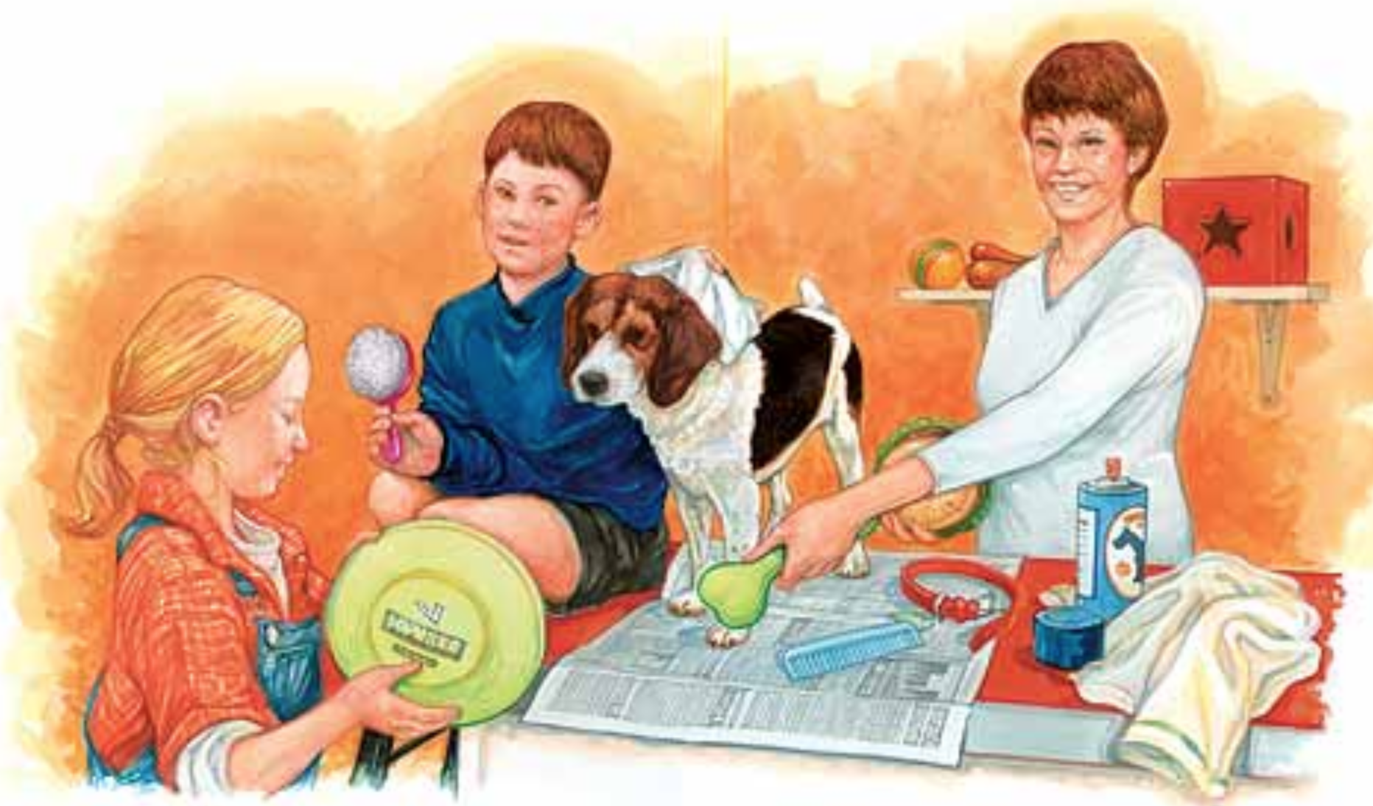
Prompt: What is an important idea from this text? Start by stating your claim. Support your claim and come to a consensus.
TEACHER VISUAL TEXT
Notes:
Display the Student Visual Text
Direct students to use their Think Time

Slide 42
Listen to the Model Constructive Conversation
  Use your think time to study the visual text.
Listen actively to what two partners say to each other.
Notes:
Provide a copy of the Model Script to the volunteer and allow time beforehand for student to review the script. Suggestions for reading the script:
● Show a video of students having the model conversation (optional)
● Model with a student using the Model Script.

Slide 43
Visual Text Model
What is an important idea from this text? Start by stating your claim. Support your claim and come to a consensus.
Partner A: An important idea from this text is that dogs need to be cared for by getting groomed. What is your idea?
Partner A: I think the dog is getting groomed. The woman, the boy and the little girl are brushing him and washing the dog using the spray and the towel. How can we support your claim with evidence?
Partner A: I think they are caring for the dog by making sure he is clean. The boy is using a towel on the dog’s head. He is also holding a hair brush. How can you support your idea with evidence?
Partner A: I think that grooming is an important part of caring for a dog. Can we come to an agreement?
Partner B: An important idea from this text is that exercise is an important thing all dogs need. How can you support your claim with evidence?
Partner B: I think the little girl is taking the dog out so she can play with it. She is holding a Frisbee. She is taking the dog out so it can exercise. How can you support your idea with evidence?
Partner B: I also notice a leash and a collar. I think the little girl will use it to walk the dog so he can exercise. What other evidence can support your claim?
Partner B: I think the important idea we came to a consensus on is that in order to care for dogs we need to groom them and exercise them.

Slide 45
Listen to the Non-Model Constructive Conversation
  Use your think time to study the visual text.
Listen actively to what two partners say to each other.
WHAT DO YOU NOTICE IN THE VISUAL TEXT? CITE DETAILS TO CLARIFY YOUR IDEAS.
Notes:
Provide a copy of the Non-Model Script to the volunteer and allow time beforehand for student to review the script. Suggestions for reading the script:
● Show a video of students having the model conversation (optional)
● Model with a student using the Non-Model Script.

Slide 46
Visual Text Non-Model
What is an important idea from this text? Start by stating your claim. Support your claim and come to a consensus.
Partner A: An idea is we need to wash out dogs. What is your idea?
Partner A: I think the dog is getting brushed. What is your evidence?
Partner A: I think they are cleaning the dogs. How can we support your idea with evidence?
Partner A: Can we come to agreement?
Partner B: The visual text shows that it is important to walk all dogs. You go next.
Partner B: The girl has a Frisbee. She is going to play.
Partner B: The mom is making the dog safe. What other evidence can support your claim?
Partner B: I think the important idea we came to a consensus on is that we love our dogs.

Slide 47
Constructive Conversation Game
PROMPT:
What is an important idea from this text? Start by stating your claim. Support your claim and come to a consensus.
Rules of the game:
Each of you needs 1 CREATE, 1 CLARIFY, 1 FORTIFY, and 2 NEGOTIATE cards
Each of you will play one card as you share an idea. You will continue taking turns until all cards are placed in the middle.
If you’re done early repeat the process for an additional round.
Remember to use the Constructive Conversation Norms and Skills as you play the game.
Notes:
You are now going to have the opportunity to practice the Constructive Conversation Skill NEGOTIATE while playing a game.
Explain the rules of the Constructive Conversation Game to students.

Slide 48
Prompt: What is an important idea from this text? Start by stating your claim. Support your claim and come to a consensus.
TEACHER COLLECTS LANGUAGE SAMPLE SPF 1.0
STUDENT VISUAL TEXT
Notes:
Display the Student Visual Text
Direct students to use their Think Time
As the students play the game, the teacher listens and selects two students who will replay the game in front of the class to serve as models.
This is an opportunity to capture a language sample.

Slide 49
CONSTRUCTIVE CONVERSATION
FISHBOWL MODEL
PROMPT: What is an important idea from this text? Start by stating your claim. Support your claim and come to a consensus.
Listen actively to what two partners say to each other.
FORMATIVE ASSESSMENT– TEACHER COLLECTS LANGUAGE SAMPLE SPF 1.0
Notes:
The two selected students will replay the game in front of the class and serve as models.
Student Progress Form (SPF)-­‐‑ Constructive Conversation Language Sample The teacher will collect a language sample from the two students on the Student Progress Form (SPF)-­‐‑ Constructive Conversation Language Sample to be used in Lesson 2. The language sample must be at least four turns in length. (Each turn includes both Partner A and B sharing

Slide 50
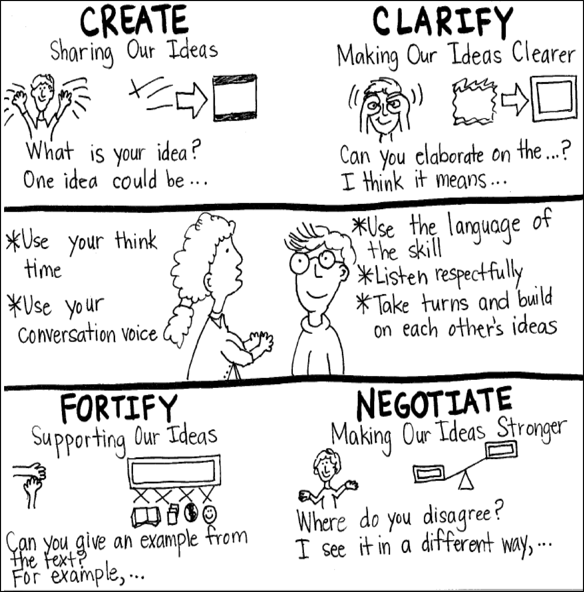
Model Creating Class Constructive Conversation Poster
Sample
Notes:
Teacher models creating a Constructive Conversation Poster. This slide is a resource. Teacher elicits student responses to help student develop a poster that illustrates their understanding of the NEGOTIATE skill and conversation norms.

Slide 51
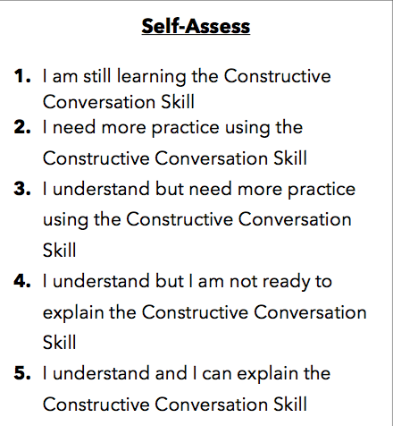
Notes:
Teacher will review the Constructive Conversation Skill NEGOTIATE
Students will self-assess answering the prompt
Teacher may select a conversation pair to share out.
EXAMPLE:
Student: I rated myself a 3 because…
Teacher: What can you do to move to a 4?

Slide 52
Teacher Resources

Slide 53
NEGOTIATE Non-Model Revision

